Slide 1
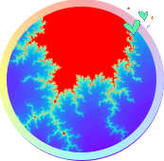
重庆大学
C++编程基础及应用
第5章 数组及字符串
高等教育出版社 第1版
重庆大学 海洋饼干叔叔
使用WPS播放效果最佳

Slide 2

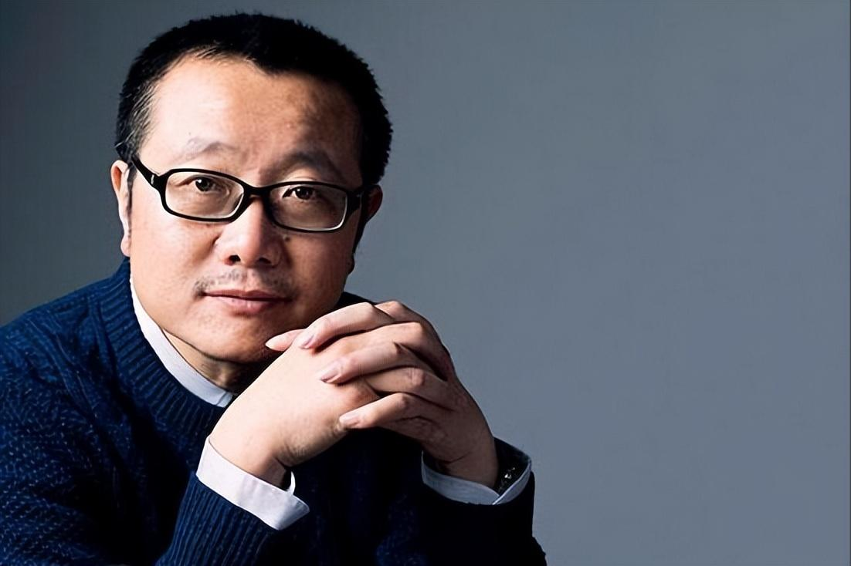
下面的大地上，方阵均匀的色彩开始出现扰动，复杂精细的回路结构浮现出来，并渐渐充满了整个方阵，十分钟后，大地上出现了一块三十六平方公里的计算机主板。
——刘慈欣《三体》

Slide 3
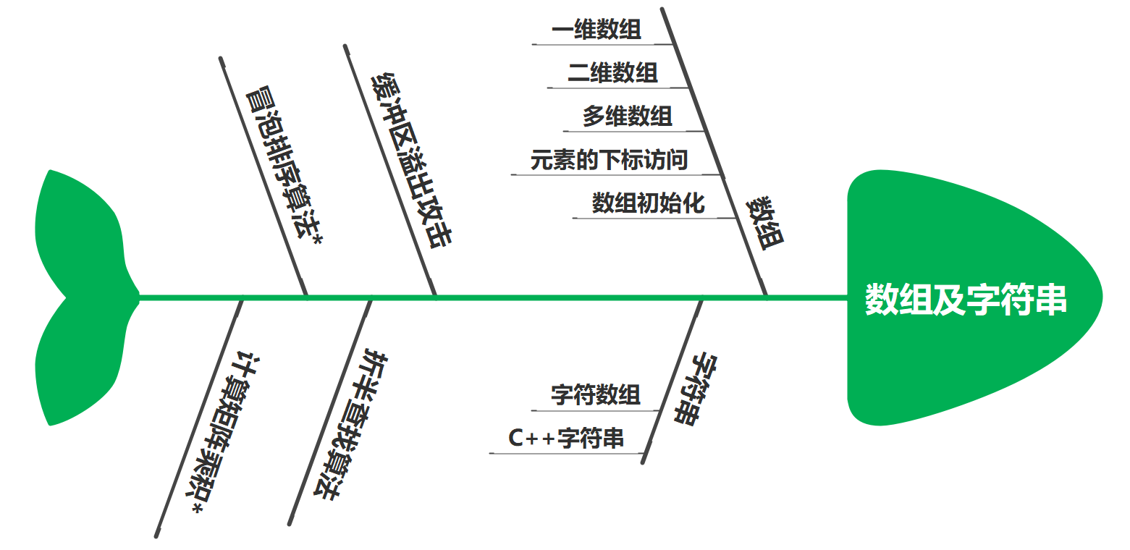
5. 数组及字符串

Slide 4
5.1 一维数组
数组（array）可以在连续的空间里存储相同类型的多个对象。
元素类型 数组名[元素个数];

Slide 5
执行结果
sizeof(scores) = 20 scores = 0x61fe00 0x61fe00 - 0x61fe04 - 0x61fe08 - 0x61fe0c - 0x61fe10 Average score = 89.5
5.1 一维数组
//Project - Scores
#include <iostream>
using namespace std;
int main() {
float scores[5] = {77,92.5,68,99,100};
scores[0] = 88;
cout << "sizeof(scores) = " << sizeof(scores) << endl;
cout << "scores = " << scores << endl;
cout << &scores[0] << " - " << &scores[1] << " - " <<
&scores[2] << " - " << &scores[3] << " - " << &scores[4] << endl;
float fSum = 0;
for (int i=0;i<5;i++)
fSum += scores[i];
float fAverage = fSum / 5;
cout << "Average score = " << fAverage;
return 0;
}

Slide 6
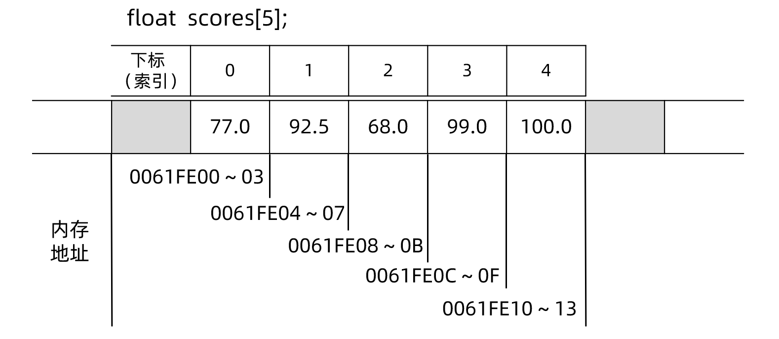
5.1 一维数组

Slide 7
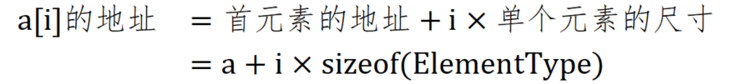
5.2 元素的下标访问

Slide 8
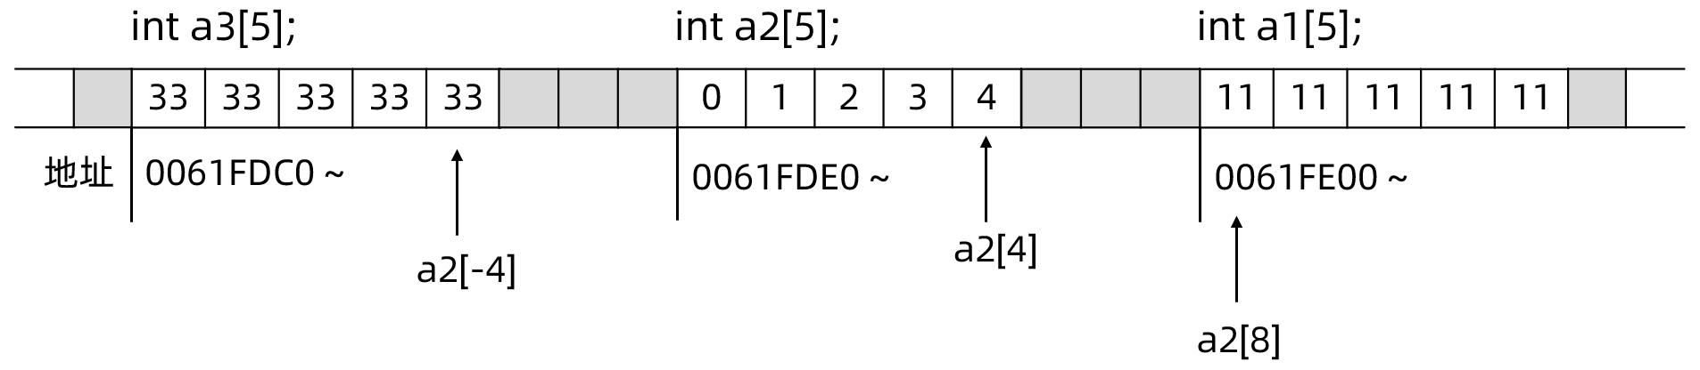

5.2 元素的下标访问
//Project - Subscript
#include <cstdio>
int main() {
int a1[5] = {11,11,11,11,11};
int a2[5] = {0,1,2,3,4};
int a3[5] = {33,33,33,33,33};
printf("%p - %p - %p\n",a1,a2,a3);
printf("%d,%d,%d,%d,%d\n",a2[0],a2[1],a2[2],a2[3],a2[4]);
printf("a2[-4] = %d\n",a2[-4]);
printf("a2[8] = %d\n",a2[8]);
return 0;
}
执行结果
000000000061FE00 - 000000000061FDE0 - 000000000061FDC0 0,1,2,3,4 a2[-4] = 33 a2[8] = 11
用C++编程，就象是闪电侠快速地奔跑在布满地雷的雷区，又快又危险。

Slide 9
5.3 数组初始化
short dummy[10] = {1,2}; //前两个元素初始化为1和2，其余元素初始化为0
short dummy[10] = {}; //元素值全部初始化为0
short dummy[10] = {0}; //元素值全部初始化为0
double dummy[1000]; //元素值不确定
double d[] = {1.2,3.2,888,99.12};
printf("%d",sizeof d / sizeof(double)); //元素个数 = 数组尺寸 / 元素尺寸
char d1[5] {'a',120,'K',',','?'};
char d[] {12.0,'L',250}; //报错：250超出储值范围，12.0类型收窄

Slide 10
算法 - 折半查找
顺序查找 - 遍历数组
//Project - SeqSearch
#include <iostream>
using namespace std;
int main() {
const int N = 30;
int h[N] = {175,161,162,169,147,170,170,152,171,155,157,166,157,158,160,161,161,163,164,165,
173,175,165,166,166,168,168,147,169,170};
int iSearchValue = 173; //需要查找的值
int iIndex = -1; //结果下标, <0表示未找到
for (int i=0;i<N;i++){
if (h[i] == iSearchValue){
iIndex = i;
break;
}
}
if (iIndex<0)
cout << "Not found.";
else
cout << "h[" << iIndex << "] = " << iSearchValue;
return 0;
}
执行结果
h[20] = 173
最坏情况计算复杂性：Θ(N)

Slide 11
算法 - 折半查找
当h[N]数组递增有序时，可以使用折半查找。
01
02
03
找中位元素
比较
迭代
上述过程每进行一次，我们至少能将目标元素的搜索范围减小一半，复述上述过程，直到搜索范围为空，或者找到目标元素为止。
然后将中位元素与查找关键字进行比较；如果中位元素小于关键字，说明目标元素只能在中位元素的右边；如果... 左边；如果中位元素恰好等于关键字，那说明我们十分幸运，直接找到了目标元素。
首先找出当前查找范围的中位元素，就本例而言，应为数组h中下标14的元素；

Slide 12
算法 - 折半查找
//Project - BinarySearch
#include <iostream>
using namespace std;
int binarySearch(const int a[], int left, int right, const int key){
while (left<=right){
int mid = (left+right)/2;
if (a[mid]<key)
left = mid + 1;
else if (a[mid]>key)
right = mid - 1;
else
return mid; //在下标mid处找到key，返回mid
}
return -1; //未找到，返回负数下标
}
最坏情况计算复杂性：θ(log₂N)

Slide 13
执行结果
Input the number to search:173 h[28] = 173
算法 - 折半查找
int main() {
const int N = 30;
int h[N] = {145,147,147,152,155,157,157,158,160,161,
161,161,162,163,164,165,165,166,166,166,
168,168,169,169,170,170,170,171,173,175};
int iSearchValue = 0;
cout << "Input the number to search:";
cin >> iSearchValue;
int r = binarySearch(h,0,N-1,iSearchValue);
if (r<0)
cout << "Not found.";
else
cout << "h[" << r << "] = " << iSearchValue;
return 0;
}

Slide 14
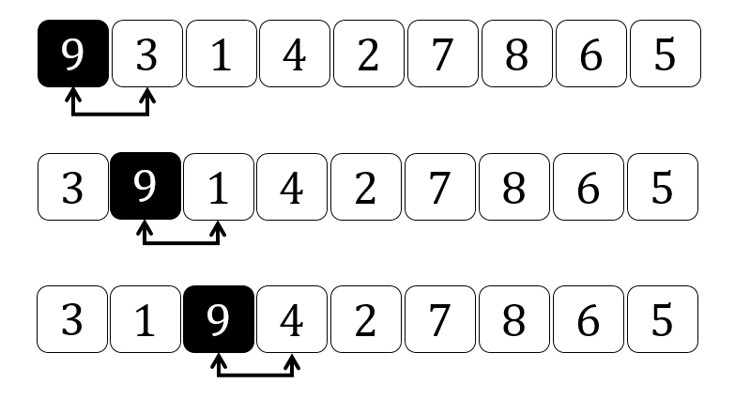
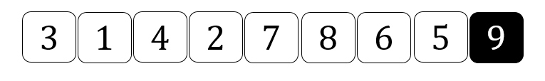
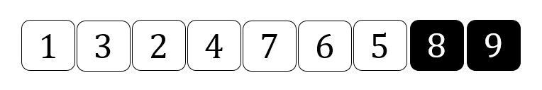
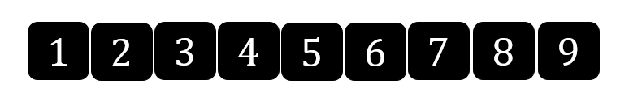
算法 - 冒泡排序*
计算复杂性：θ(n²)

Slide 15
算法 - 冒泡排序*
//Project - BubbleSort
#include <iostream>
using namespace std;
void bubbleSort(int a[], const int n){
for (int i=n-1;i>0;i--)
for (int j=0;j<i;j++){
if (a[j] > a[j+1]){
int t = a[j];
a[j] = a[j+1];
a[j+1] = t;
}
}
}
int main() {
int data[] = {3,9,1,4,7,6,5,8,2};
bubbleSort(data,9);
cout << "Sorted array: ";
for (int i=0;i<9;i++)
cout << data[i] << ",";
return 0;
}
计算复杂性：θ(n²)
执行结果
Sorted array: 1,2,3,4,5,6,7,8,9,

Slide 16
执行结果
s1 = hello, addr = 000000000061FE06, sizeof s1: 6 s1 = 104 101 108 108 111 0 s2 = FORREST, addr = 000000000061FD00, sizeof s2: 256 'A' = 65, 'a' = 97
5.4 字符数组
//Project - CStyleString
#include <cstdio>
int main() {
char s1[] = "hello";
printf("s1 = %s, addr = %p, sizeof s1: %lld\n", s1, s1, sizeof s1);
printf("s1 = %d %d %d %d %d %d\n",s1[0],s1[1],s1[2],s1[3],s1[4],s1[5]);
char s2[256] = "forrest";
int i = 0;
while (s2[i]!=0){
s2[i] = s2[i] + ('A' - 'a');
i++;
}
printf("s2 = %s, addr = %p, sizeof s2: %lld\n", s2, s2, sizeof s2);
printf("'A' = %d, 'a' = %d",'A','a');
return 0;
}

Slide 17
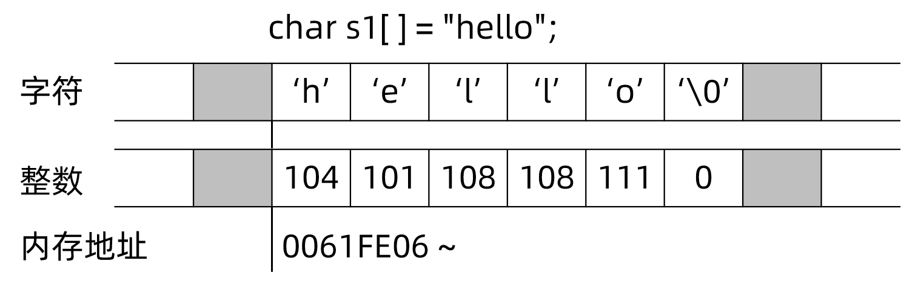
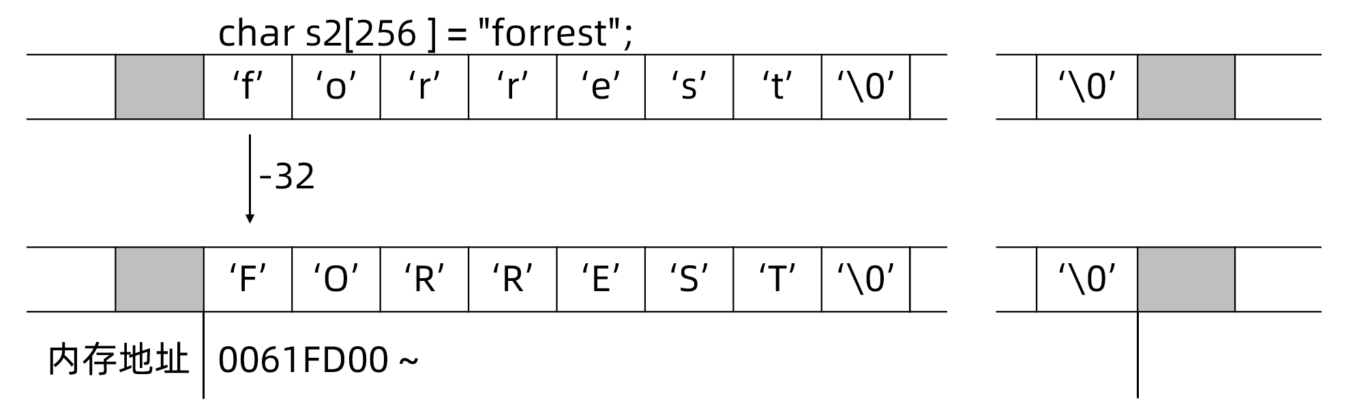
5.4 字符数组

Slide 18
5.4 字符数组
C++用单引号包裹单个字符，用双引号包裹字符串
char c = 'c'; //正确：单引号包裹单个字符
char d = "d"; //错误：双引号包裹字符串
char e[] = "e"; //正确，字符串可以只包含单个字符（事实上是'e'和'\0'两个字符)
char f[] = 'f'; //错误，单个字符不能构成字符串

Slide 19
微实践 - 缓冲区溢出攻击
//Project - CrackPassword
#include <iostream>
#include <cstring>
using namespace std;
int main(){
char sActualPass[8] = "secret";
char sInputPass[8] = "";
while (1){
cout << "Enter your password:";
cin >> sInputPass;
if (strcmp(sInputPass,sActualPass)==0){
cout << "Login sucessfully.\n";
break;
}
else
cout << "Wrong password.\n";
}
cout << "Start using the system...\n";
return 0;
}
执行结果
Enter your password:12345678crack Wrong password. Enter your password:crack Login sucessfully. Start using the system...

Slide 20
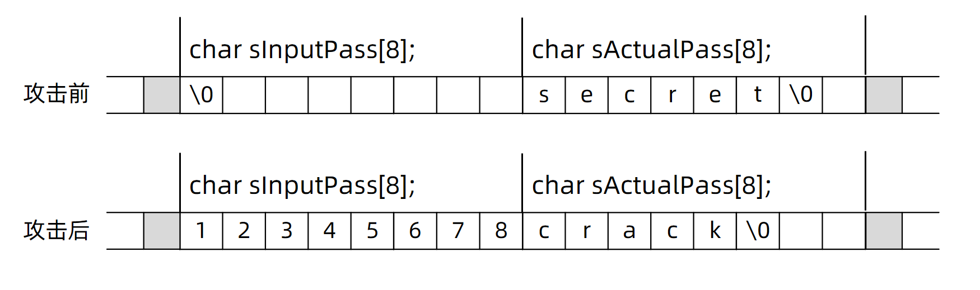
微实践 - 缓冲区溢出攻击
printf("addr of sInputPass,sActualPass:%p,%p\n",sInputPass,sActualPass);

Slide 21
5.5 C++字符串
执行结果
s1 = HELLO, size = 5, sizeof(s1) = 32 s1 = HELLO World! s2 = Hello World! s3 = HELLO World! s4.substr(17,10) = chocolates s4.find("chocolates") = 17 s4 after replace = Life is a box of CHOCOLATES, you...
//Project - CppString1
#include <iostream>
#include <string>
using namespace std;
int main() {
string s1 {"hello"};
for (unsigned int i=0;i<s1.size();i++)
s1[i] += ('A' - 'a');
cout << "s1 = " << s1 << ", size = " << s1.size()
<< ", sizeof(s1) = " << sizeof(s1) << endl;
string s2 = " World!";
string s3 = s1 + s2;
s1 += s2;
s2 = "Hello" + s2;
cout << "s1 = " << s1 << " s2 = " << s2 << " s3 = " << s3 << endl;
string s4 = "Life is a box of chocolates, you...";
cout << "s4.substr(17,10) = " << s4.substr(17,10) << endl;
auto iPos = s4.find("chocolates");
cout << "s4.find(\"chocolates\") = " << iPos << endl;
s4.replace(iPos,10,"CHOCOLATES");
cout << "s4 after replace = " << s4 << endl;
return 0;
}

Slide 22

扩展阅读 UTF-8编码及非英文字符的处理与显示
符号 | 编码（整数,16进制） | 说明
B | 42 | 英文字符
Ê | 00CA
ڣ | 06A3 | 阿拉伯语字符
ॵ | 975 | 未知语言字符
ᅰ | 1170 | 韩语符号
∫ | 222B | 数学符号之积分
⛺ | 26FA | 帐篷
ざ | 3056 | 日语假名
人 | 4EBA | 汉字
UTF-8编码

Slide 23

5.6 二维数组
表5-1 成绩单
 | 课程0 | 课程1 | 课程2 | 课程3 | 课程4
学生0 | 67 | 98 | 77 | 80 | 86
学生1 | 56 | 89 | 45 | 76 | 63
学生2 | 78 | 69 | 96 | 67 | 99
学生3 | 88 | 19 | 78 | 55 | 68
float scores0[5] = {67, 98, 77, 80, 86}; //学生0的成绩
float scores1[5] = {56, 89, 45, 76, 63}; //学生1的成绩
float scores2[5] = {78, 69, 96, 67, 99}; //学生2的成绩
float scores3[5] = {88, 19, 78, 55, 68}; //学生3的成绩

Slide 24
执行结果
scores = 000000000061FDC0, sizeof(scores) = 80 scores[0~3] = 000000000061FDC0 000000000061FDD4 000000000061FDE8 000000000061FDFC &scores[1][0~2] = 000000000061FDD4 000000000061FDD8 000000000061FDDC &scores[1~2][1] = 000000000061FDD8 000000000061FDEC Average of scores[1][0~4] = 76.80
5.6 二维数组
//Project - TwoDim
#include <cstdio>
int main() {
float scores[4][5] = {
{67, 98, 77, 80, 86},
{56, 89, 45, 76, 63},
{78, 69, 96, 67, 99},
{88, 19, 78, 55, 68}
};
scores[1][2] = 100;
printf("scores = %p, sizeof(scores) = %lld\n",scores, sizeof(scores));
printf("scores[0~3] = %p %p %p %p\n",scores[0],scores[1],scores[2],scores[3]);
printf("&scores[1][0~2] = %p %p %p\n",&scores[1][0],&scores[1][1],&scores[1][2]);
printf("&scores[1~2][1] = %p %p\n",&scores[1][1], &scores[2][1]);
float fSum = 0;
for (unsigned int j=0;j<5;j++)
fSum += scores[1][j];
float fAverage = fSum / 5;
printf("Average of scores[1][0~4] = %.2f",fAverage);
return 0;
}

Slide 25
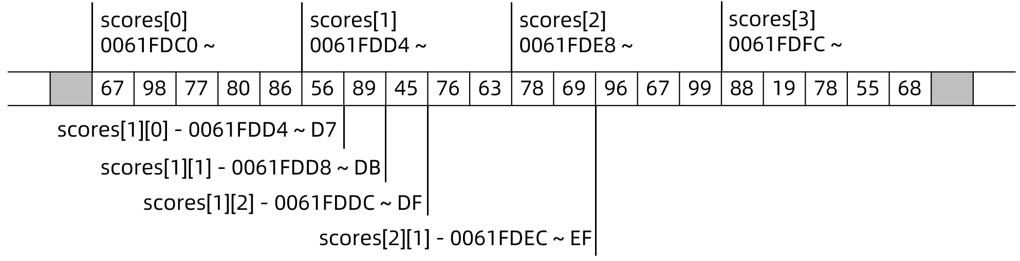
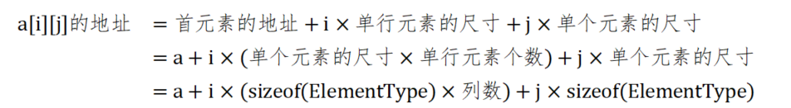
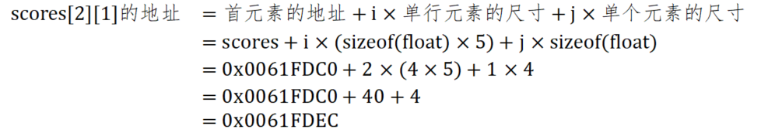
5.6 二维数组

Slide 26
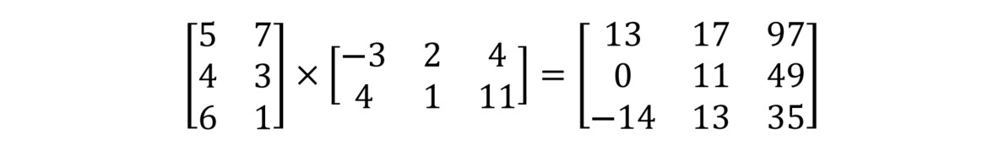
算法 - 计算矩阵乘积*
矩阵乘法

Slide 27
执行结果
a = 000000e0d17ffa50, sizeof(a) = 24 a[1][1][1] = 111
5.7 多维数组*
//Project - ThreeDim
#include <cstdio>
int main(){
short a[2][2][3] = {
{
{0,1,2},
{10,11,12}
},
{
{100,101,102},
{110,111,112}
}
};
printf("a = %p, sizeof(a) = %lld\n",a,sizeof(a));
printf("a[1][1][1] = %d",a[1][1][1]);
return 0;
}
多维数组

Slide 28
End of Chapter 5
重庆大学 海洋饼干叔叔

